Slide 1

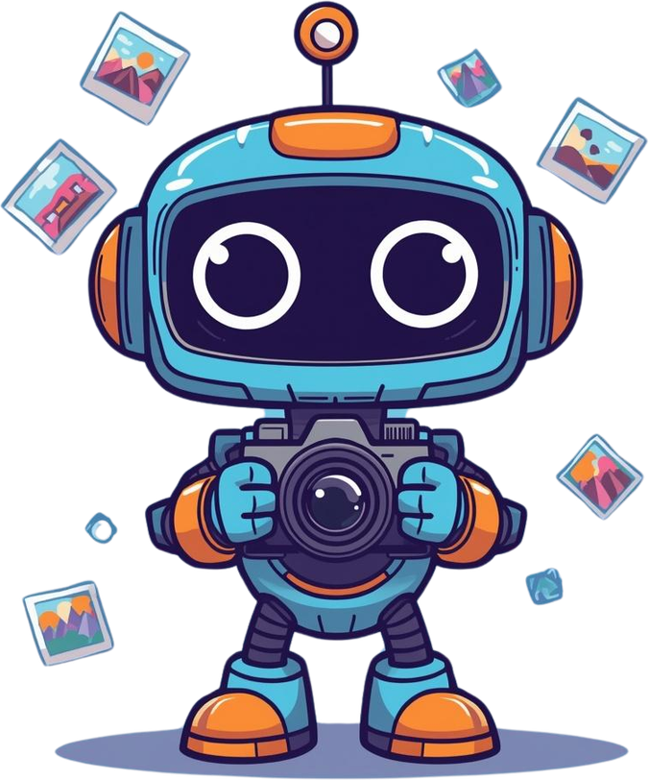
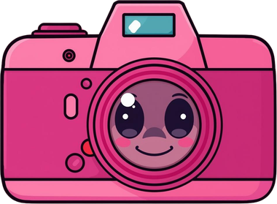
TEACHING MACHINES – IMAGE CLASSIFICATION
How Machines Learn to Recognize Pictures

Slide 2

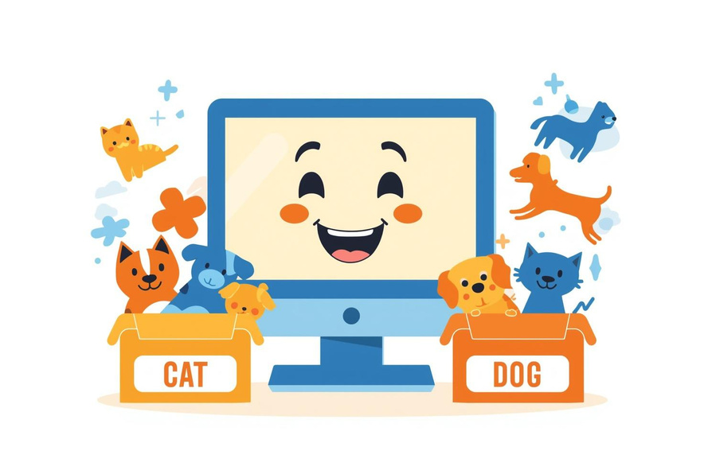
WHAT IS IMAGE CLASSIFICATION?
Image Classification means teaching a computer to look at pictures and decide what they show.
Think of it like sorting photos into groups—cats in one pile, dogs in another!
The computer learns to recognize patterns in pictures, just like you can tell the difference between a cat and a dog by looking at them.

Slide 3

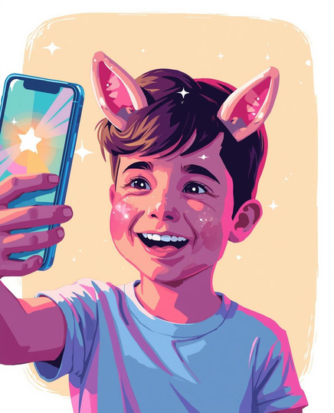
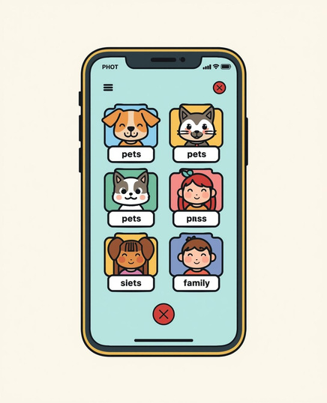

REAL-WORLD EXAMPLES YOU KNOW
Face Filters
Photo Sorting
Smile Detection

Slide 4

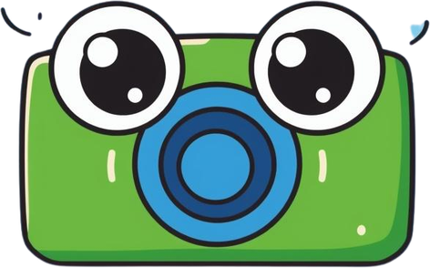
HOW DO MACHINES LEARN TO SEE?
3
1
2
Collect Pictures: Gather lots of photos of what you want the machine to learn!
Test It Out: See if the machine can correctly guess new pictures!
Train the Model: Show the computer these pictures so it can learn patterns!

Slide 5
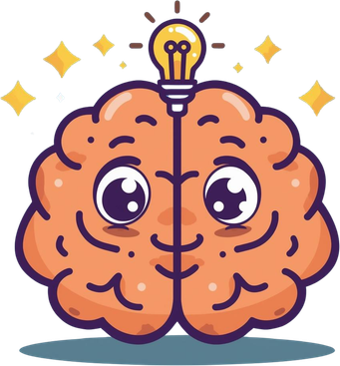
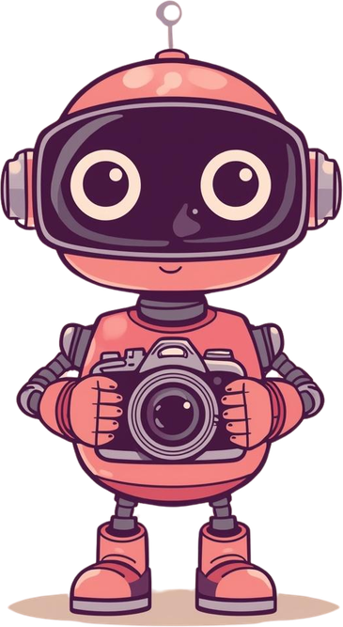

YOUR TURN!
TEACH A MACHINE!

